Slide 1
Dynamic Data Ingestion and Storage in HDFS with Automated Hive Integration
Apekshaa

Slide 2
INTRODUCTION
The task involves fetching data from a specified link, storing it in HDFS, and creating a Hive table for visualization.
Start by ensuring the link is accessible and that data retrieval is successful.
Next, determine the data format and schema, if structured.
Use wget or curl for data download and HDFS CLI for storage.
Then, create a Hive table, load the data, and verify its correctness. Optionally, automate the entire process with a script.

Slide 3
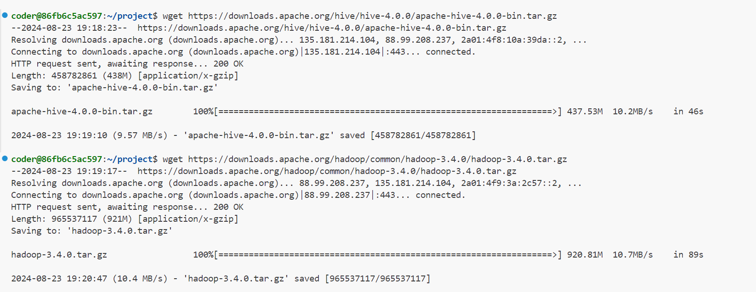
DOWNLOAD AND INSTALL HADOOP AND HIVE

Slide 4
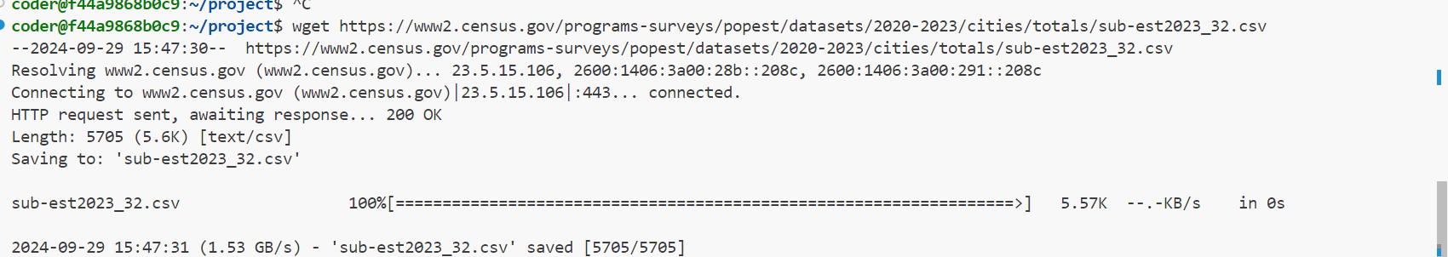
DOWNLOADING THE DATA FILE
Step 2: Download the Data File

Slide 5
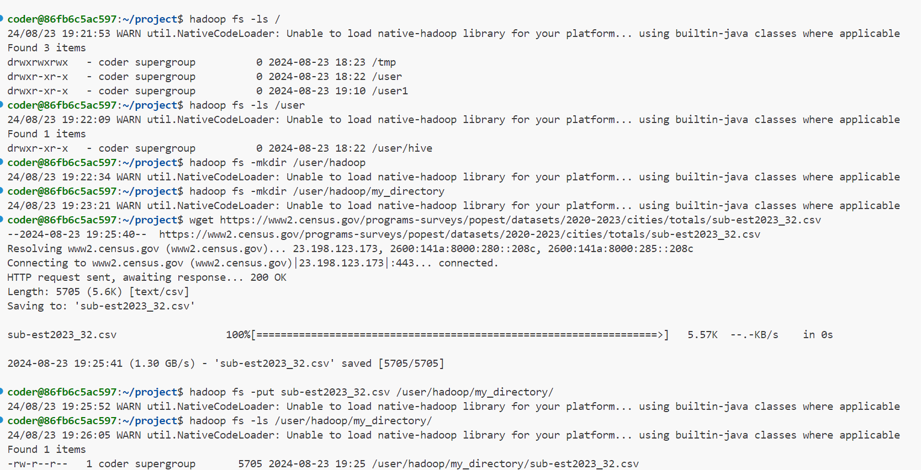
SETTING UP HDFS AND PUSH THE DATA INTO TABLE

Slide 6
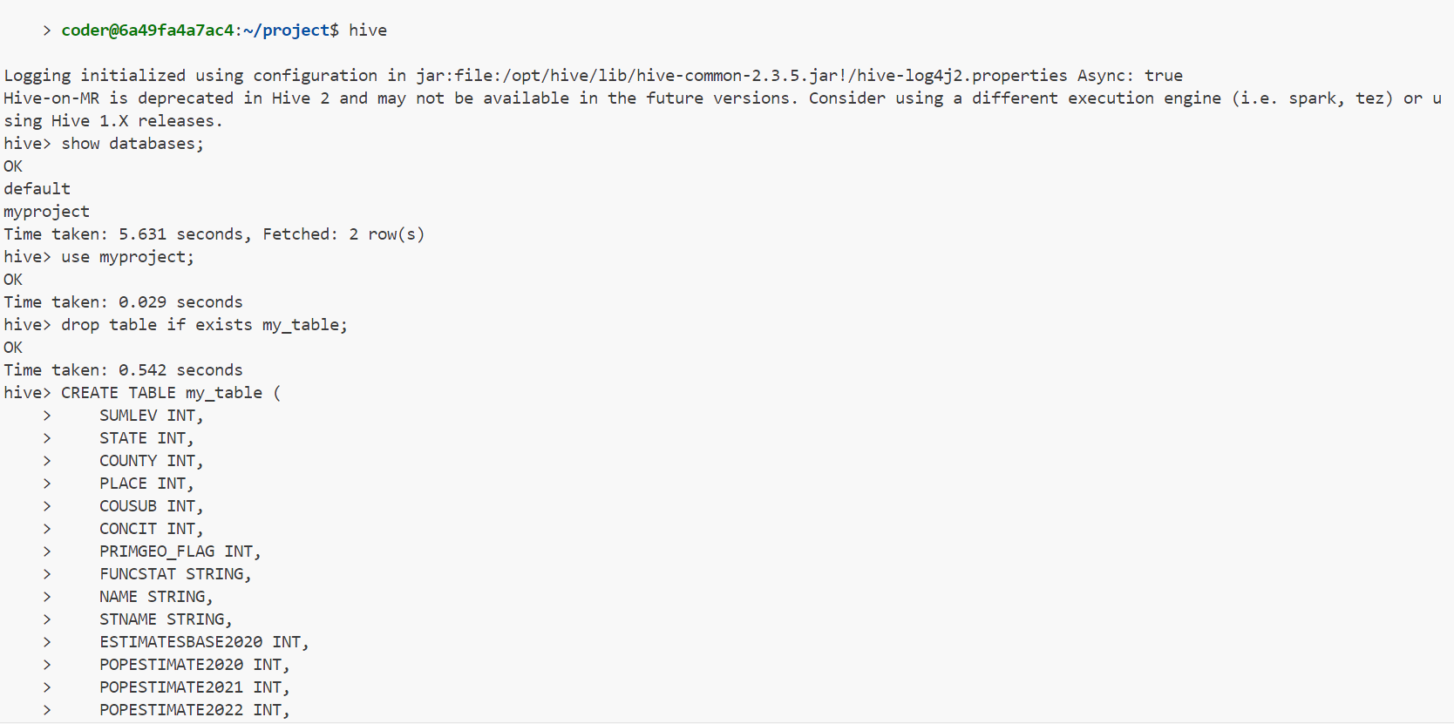
SETTING UP HIVE AND CREATE TABLE

Slide 7
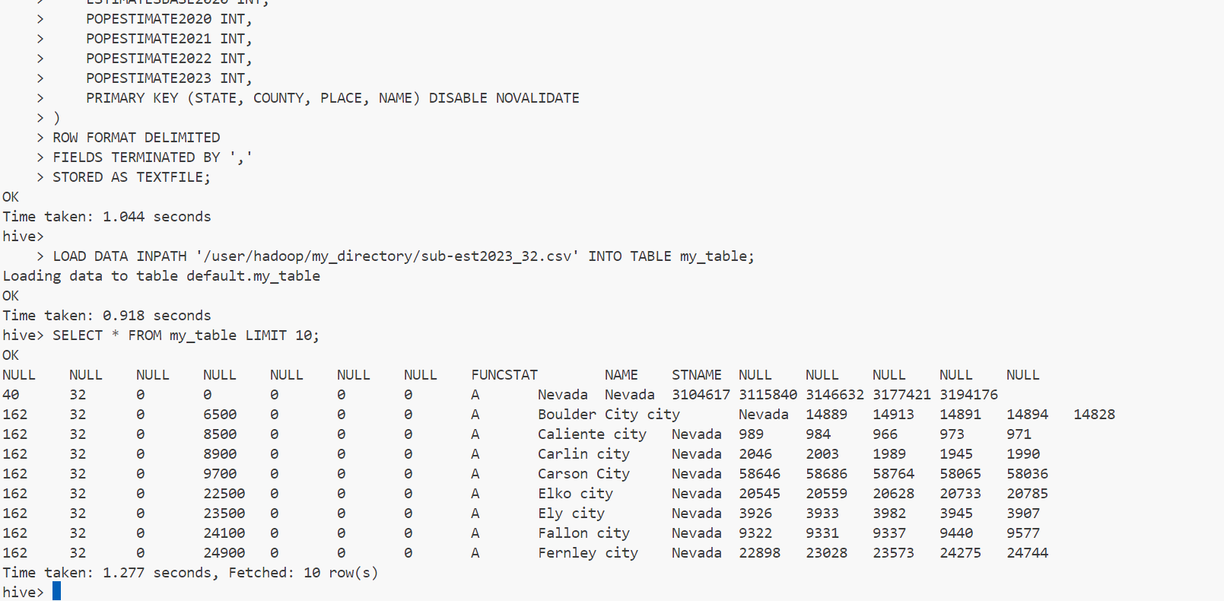
LOAD THE DATA INTO THE TABLE AND VERIFY

Slide 8
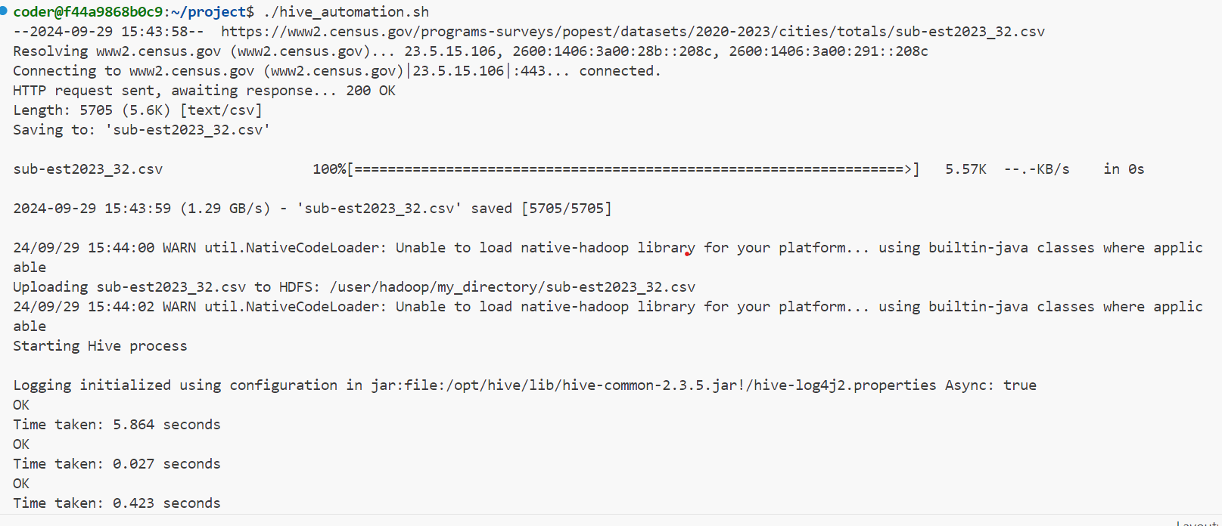
AUTOMATE THE SCRIPT

Slide 9
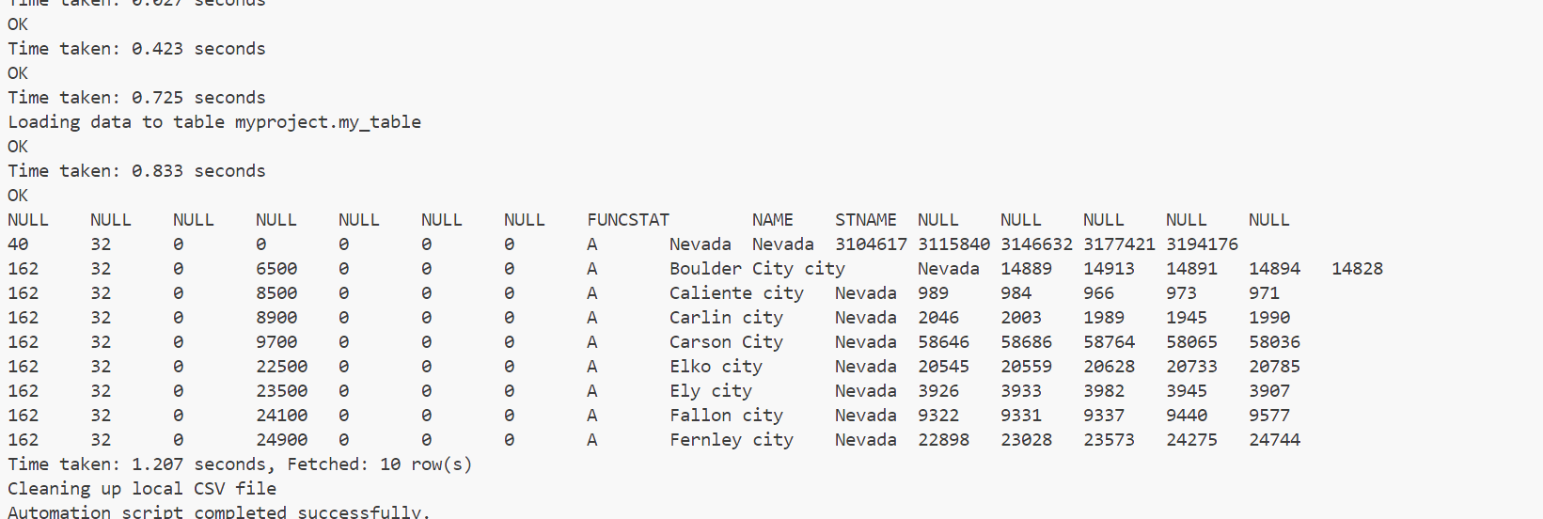
AUTOMATE THE SCRIPT

Slide 10
THANK YOU

